Slide 1
ICELAND 2025: 13th-16th FEBRUARY information evening

Slide 2
Flight details
Feel free to track the flights using the flight number and locator. This will be important in order to gauge an ETA on arrival back to school.

Slide 3
Departure and arrival details
We will be travelling together to the airport.
We will meet at Bacons College at 2am on Thursday. The coach will depart at 02.30am. You must be on time!
We will arrive at Heathrow around 14.55pm. We will then get a coach back to Bacon's College. 17.00pm.

Slide 4
Itinerary- DAY ONE
02:00 hrs | Meet at Bacons College.
02:30 hr | Leave Bacons College
04:30 hrs | Arrival and check in at Heathrow- flight NO BA 894.
07:24 hrs | Flight departs
10:45 hrs | Arrive at Keflavik International Airport (local time)
11:45 hrs | Arrival at Blue Lagoon
14:00 hrs | Visit ends and depart on coach
15:00 hrs | Arrive at hotel (Hotel Cabin)
16:00 hrs | Trip into Reykjavik
19:00 hrs | Dinner at hotel
 | Group to spend the evening at leisure

Slide 5
Itinerary DAY TWO

Slide 6
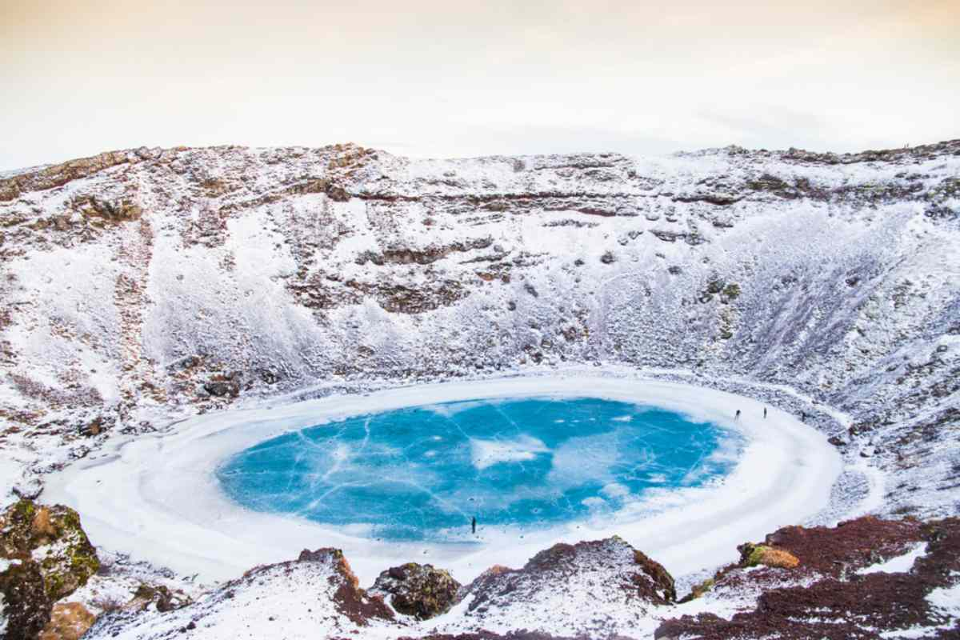
Itinerary day three

Slide 7
Itinerary day four

Slide 8
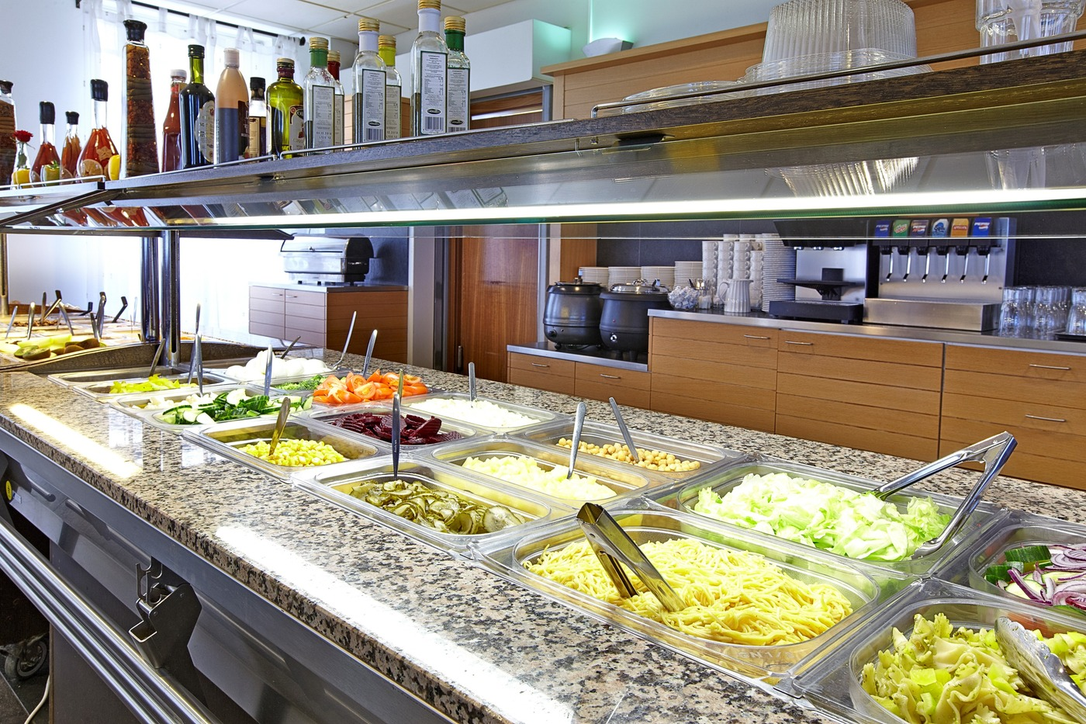
Hotel details
Hotel Cabin
Borgartún 32, 105 Reykjavík, Iceland
Students will be provided with all 3 meals and will be sharing rooms of 2 or 3.

Slide 9
INSURANCE
A summary of the insurance policy is included in the pack you have.

Slide 10
GLOBAL HEALTH INSURANCE CARD
EHIC: Current European Health Insurance Cards (EHIC) are valid as long as they are in date. When your EHIC has expired you need to apply for a new Global Health Insurance Card (GHIC). The new GHIC card is free to obtain from the official website and should be applied for at least 4 weeks before travel:
https://www.nhs.uk/using-the-nhs/healthcare-abroad/apply-for-a-free-uk-global-healthinsurance-card-ghic/
Both cards will offer equivalent protection for emergency and medically necessary healthcare needs when in the EU on holiday.

Slide 11
Passport
A valid passport is required.
The travel company requires travellers to have a passport expiry date of at least 6 months after the day we leave, which means they must have an expiry date any time after 13th August 2025. 3 months is the absolute minimum (13th May 2025)
Please complete the link sent via text with all passport information.

Slide 12
What to bring
One large suitcase (Max. 23kg / 51lbs and up to 56 x 45 x 25cm / 22 x 18 x 10in) and carry on (Max. 10kg / 51lbs and up to 40 x 30 x 15cm / 16 x 12 x 6in)
Toiletries
Very warm and waterproof jacket and trousers
Long sleeve tops, including thermals
Hat and gloves
Comfortable, waterproof shoes (walking shoes ideally)
Swimwear
Bath towel *Optional
Pyjamas
Water bottle
Snacks (in suitcase)
Leisure wear
Plastic bag for dirty clothes
Money for snacks and souvenirs (optional)
Books/games for free time (optional)
Phone charger and two-pin plug adapter

Slide 13
Safety and behavior
Keeping safe whilst we are away is very important. Therefore, each child will be given a “I’m lost” card to carry on their person whenever we are on outdoor activities. The card will be in a booklet that will consist of accommodation details and a number to call the trip leader.
While we are away, please remember your child’s behaviour represents our school. Therefore, your child is expected to conduct themselves appropriately and have respect for both staff and their peers. We want everyone to have an enjoyable experience. This goes for students 18+, we have a duty of care to ensure their safety.
Phones will be allowed but we urge all to limit their use in order to fully enjoy the experience! Also, mobile data will cost for some providers, but WIFI is provided at the hotel.

